Slide 1
Python Summer Camp 2017

Slide 2

A little about me
Sophomore Software Engineering student at Iowa State University
Prior to my first semester in college I had very limited experience with coding!
If I can do it, so can you!
Notes:
I just changed my major to Software Engineering last December

Slide 3
Programming Languages
They are a little different than speaking languages (Spanish, English, French)
There are many, many, MANY types of programming languages out there
Different languages can be used for different things:
Building websites
Developing apps
Programming machines
In this class, we will be using the programming language Python (version 3.6)
Notes:
They aren’t a language for communicating to other people; instead, programming languages are used for communicating to a computer
Just like Chinese, French, and Spanish, there are different kinds of languages for talking to computers
(joke) in this class we will be programming in python and speaking in English (hahaha)

Slide 4
IDE: Integrated Development Environment
And IDE is a place where you can type code and interact with a programming language
Different languages have different IDEs, but some IDEs can be used for multiple programming languages

Slide 5
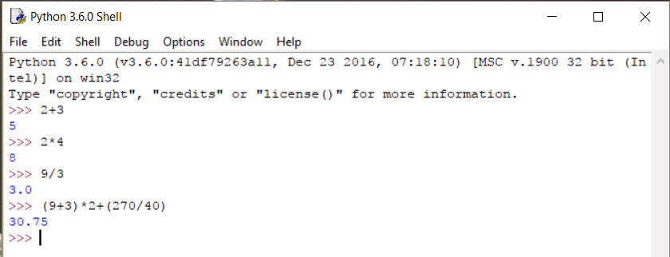
IDLE
IDLE is an IDE: Integrated Development Environment
Let’s play around with the interpreter
Try some math problems
Notes:
There are tons of different IDE’s out there, but in this class we will be using IDLE
you can use the interpreter like a calculator
PEMDAS

Slide 6
Basics of a Program
Expressions
3+2
5*4
Variables
X = 24
Y = X + 5
Conditionals
If statements
Loops
While statements
Functions
Notes:
We used expressions on the previous slide
Variables are labels for information
https://docs.google.com/presentation/d/1xAZNZUad6ze9Hj2deix8cwGGPfKhCjR4SjKwz85NSec/edit#slide=id.g23d76867ea_0_31
Reintroduce if statements

Slide 7
Expressions
Signs you can use:
Less than <
Greater than >
Equals to ==
Less than or equals to <=
Greater than or equals to >=
Not equals to !=
Evaluate the right side first!
Mathematical expressions return a value (5+4=9) and logical expressions return true or false (6<8 = true)
X == 3
X != 3
X = 7 + 5 - 3

Slide 8

Variables
Variables are like containers for information
Variable names cannot have spaces in python
Instead, use capital letters to show different words in a variable name:
thisIsMyVariableName
largestNumber
longestLetterInSentance
To assign variables, use =
largestNumber = 8
X = 12
What is the final value of y in the image
Notes:
Hershey’s kiss demonstration -> the different wrappers tell you what kind of chocolate is inside, even though you cant see the chocolate on the inside

Slide 9
Assigning Variables
Variables can change
What is the final value of x?
Dice Game
Notes:
Show how you can reassign variables with numbers and other variables
The final value of x is 12. X doesn’t change!
https://docs.google.com/presentation/d/1xAZNZUad6ze9Hj2deix8cwGGPfKhCjR4SjKwz85NSec/edit#slide=id.g23d76867ea_0_31

Slide 10
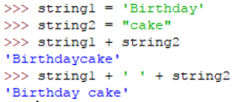
Variable Type String
Strings
Strings are words
Examples:
“python”
‘Youth Code’
“3”
To assign a value to a variable, just use =
myString = “this is a string”
You can add strings together!
Simply use +
Notes:
Strings are one of many variable types in python
Strings can be made of symbols, letters, spaces, and numbers
Strings are made using the double quotes or the single quotes – just make sure you use the same type of quotes at the beginning or the end
You can add strings together – lets try it!
Add variables and non-variable strings

Slide 11


Printing
Use print(“This is the statement I want to print”)
The print() function prints the contents of the string to the screen
Notes:
Show example
Show example of printing a variable

Slide 12

Input
Use this to get information from the keyboard
Variable = input(“This is what I want to print out”)
Variable will be of type string
Example:
Name = input(“Enter your name”)

Slide 13
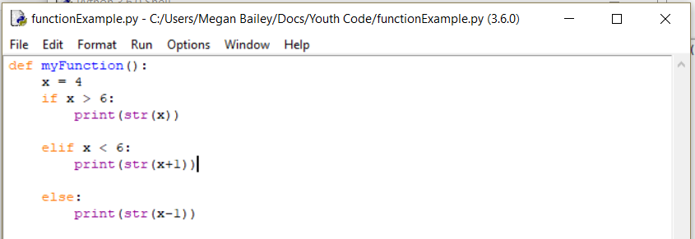
Functions
A script is a file of python code
To create a function, use def
Variables are local to functions
You can call a function in the interpreter
Notes:
Explain the difference between the interpreter and a script
You can make changes more easily in a script

Slide 14
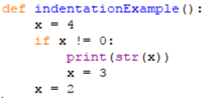
Syntax
Syntax defined by dictionary.com:
the grammatical rules and structural patterns governing the ordered use of appropriate words and symbols for issuing commands, writing code, etc., in a particular software application or programming language
Basically, syntax is how we structure things so the computer knows what we want it to do
Indentation matters with python!
Use a colon to define functions and loops
Don’t use commas in big numbers
1,000 = BAD 1000 = GOOD

Slide 15


Programming Tips
Make sure to read programs slowly and carefully. Little mistakes can cause BIG problems!
Getting frustrated will only make it harder to find the bug. Keep your cool, and calmly trace through the program
It can sometimes be helpful to grab a pencil and paper and manually keep track of your variables and loops
Notes:
Bring up bug.py file

Slide 16
Mad libs
Project 1

Slide 17

Unplugged activity
Find a partner and each take turns filling out mad libs
You should have a hand out with grammar hints if you’re a little rusty

Slide 18
madLib.py
This program will use strings, variables, input and printing
Create a program that asks the user for nouns, pronouns, adjectives, adverbs, verbs, etc.
Store the user’s input in variables
Then, insert the variables into a sentence use string concatenation
Finally, print the sentence
Remember to test your program!
Switch computers with your neighbors and try out each other’s programs!

Slide 19
Variable Type Integer
Often referred to as “int”
An int is any whole number
Examples:
4
5629
200099
We have already been using these, we just didn’t know the fancy name for it yet

Slide 20
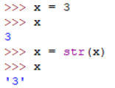
Printing non-strings
Use print(“This is the statement I want to print”)
For now, we are only going to be printing strings
To turn an int into a string, just use str():
str(3) = “3”
Changing an int to a string;
X is an int
X is a string
Notes:
Sometimes variables will be ints, but we will still want to print them.
Show example

Slide 21
Using input() with numbers
Use this to get information from the keyboard
Variable = input(“This is what I want to print out”)
The input() function PRINTS and then grabs information from the keyboard

Slide 22
Using input() with numbers
Use this to get information from the keyboard
Variable = input(“This is what I want to print out”)
The input() function PRINTS and then grabs information from the keyboard
Example:
number = input(“Guess a number”)
But somethings wrong….
“number” will be a string, but it needs to be an int for us to compare things
So to make it an int, we TYPECAST it:
number = int(input(“Guess a number”))
Wrapping int() around it changes the string to an integer (as long as the string is a string of a number)

Slide 23
Road Trip!
Project 2

Slide 24
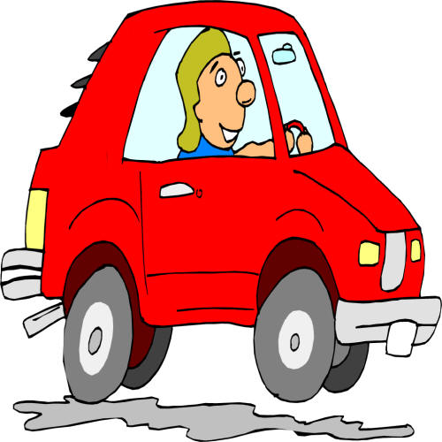
roadTrip.py
Distance ÷ Speed = Time
Distance ÷ MPG = Gallons of gas
Gallons of gas × price of gas = Cost
This program will use variables, input, and print statements
Find the time and cost of a road trip based on the distance, speed, and mpg of the car
Ask the user to input the distance, the speed, and the mpg of the car
Assume the price per gallon of gas is $2.00
Print the time and cost of the trip
Make sure you specify the units in all your print statements
Test your program on lots of different trips!

Slide 25
Conditional (if statement)
Loop (while statement)
Check condition
Check condition
true
false
true
false
*code*
*code*
Notes:
If statements are performed once
While statements can be performed an infinite amount of times
Bring up reveiwIfsandWhiles.py
Walk through it line by line
Bring up other kids examples

Slide 26

Lets make some changes to our program…
If the trip is longer than 9 hours, it will require a stay in a hotel
A hotel stay will cost $185.00 per night
So, if the trip lasts 12 hours, it requires 1 night in a hotel
If the trip is 18 hours, it will require 1 night in a hotel
If the trip is 20 hours, it will require 2 nights in a hotel
0 - 9 = 0 hotel stays
9.1 - 18 = 1 hotel stay
18.1 – 27 = 2 hotel stays
27.1 – 36 = 3 hotel stays

Slide 27

break
Break allows you to exit a loop without meeting the condition
Useful for nested loops
Example: an if statement inside of a while statement
Question: What's the difference between a return and a break statement?
Notes:
Draw the format on the board

Slide 28
Variable Type List
A list is a type of variable that can hold other variables
A list looks like:
myList = [12, 18, 4, “myString”]
To access an index in a list, use this notation:
myList[2] ( ← this is accessing the 4)
The indices of a list start at 0..1…2…….(length - 1)
Notes:
Draw on board how the indices match up with the values in the list

Slide 29
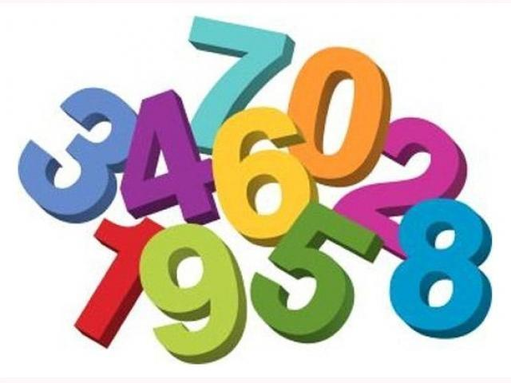
Randomization
The computer can give you simulated random numbers
But you have to tell your program where to find these functions
To do this, at the top of your function type:
from random import randint
which means: from the random library, import the randint function
randint(first available number, last available number)
Example:
randint(1,7) ← this returns either, 1, 2, 3, 4, 5, 6, or 7
Try it out in the interpreter – but don’t forget to import the randint function!
Notes:
The computer to can give you simulated random numbers
To get access to the functions that give you the random numbers, you have to include a library from python

Slide 30
Battleship
Project 3

Slide 31
Unplugged Activity
Get with a partner
Draw 3 ships on your grid (secretly!):
2 blocks, 3 blocks, 4 blocks,
Have your partner try to guess where your blocks are
If your partner guesses correctly, mark an “x” in the box
 | 1 | 2 | 3 | 4 | 5 | 6
A
B
C
D
E

Slide 32
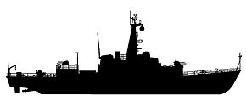
battleship.py
This program will use strings, variables, input(), print(), randomization, lists, conditionals, loops, and integers
Create a program that asks the user to guess a location (number) of a ship, and tell the user if they guessed the location of the ship or not
The user will have a limited number of attempts to guess the location of the ship
The ships location will be represented by a random integer
The ocean will be represented by a list, where the ship can be at any index of the list
If the user guesses the correct location, congratulate the user, else, ask the user to guess again IF the user is not out of tries
Remember to test your program!
Then let a friend try it out☺
Notes:
Make “tries” a parameter
How to make it not say “try again” on last try (elif)

Slide 33
Adventure
Project 4

Slide 34

Unplugged Activity
In your notebook, write out an adventure with “options”
For example, do you want to swim across the river or walk over the bridge?
The next question will be based on what choice was chosen previously
Verbally walk your partner through your adventure, giving them the options
Did they make it through the adventure unharmed?
I will walk Tim through my adventure

Slide 35

adventure.py
This program will use variables, conditionals (if/else), input, and print statements
Use input() to ask the user a series of questions, storing their answers in a single variable
There only needs to be ONE variable in the entire program
Test your program on lots of different paths!
If your program gets long, you may want to test as you go
Bonus activity: How would present and process three options, instead of two?

Slide 36
Hangman
Project 5

Slide 37
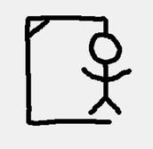
Unplugged Activity
Hangman!
Hint: the answers will be words we have used this week

Slide 38
hangman.py
This program will use strings, variables, lists, in, input, len, conditionals, loops, and printing
You will create a hangman game where the answer is a word that is hard-coded into your program
The user will have a certain number of attempts to guess the word
You will have to keep track of which letters the user has already guessed
You will have to search the correct word (string) to see if the guessed letter is in the word
Test your program for right and wrong guesses
Try changing the word and playing with your partner!

